Slide 1

A systematic search for absorption features in the X-ray spectra of ultraluminous X-ray sources Andrew Sosanya NASA NuStar team @ Caltech Department of Astrophysics, Caltech Mentors: Fiona A. Harrison & Murray Brightman

Slide 2
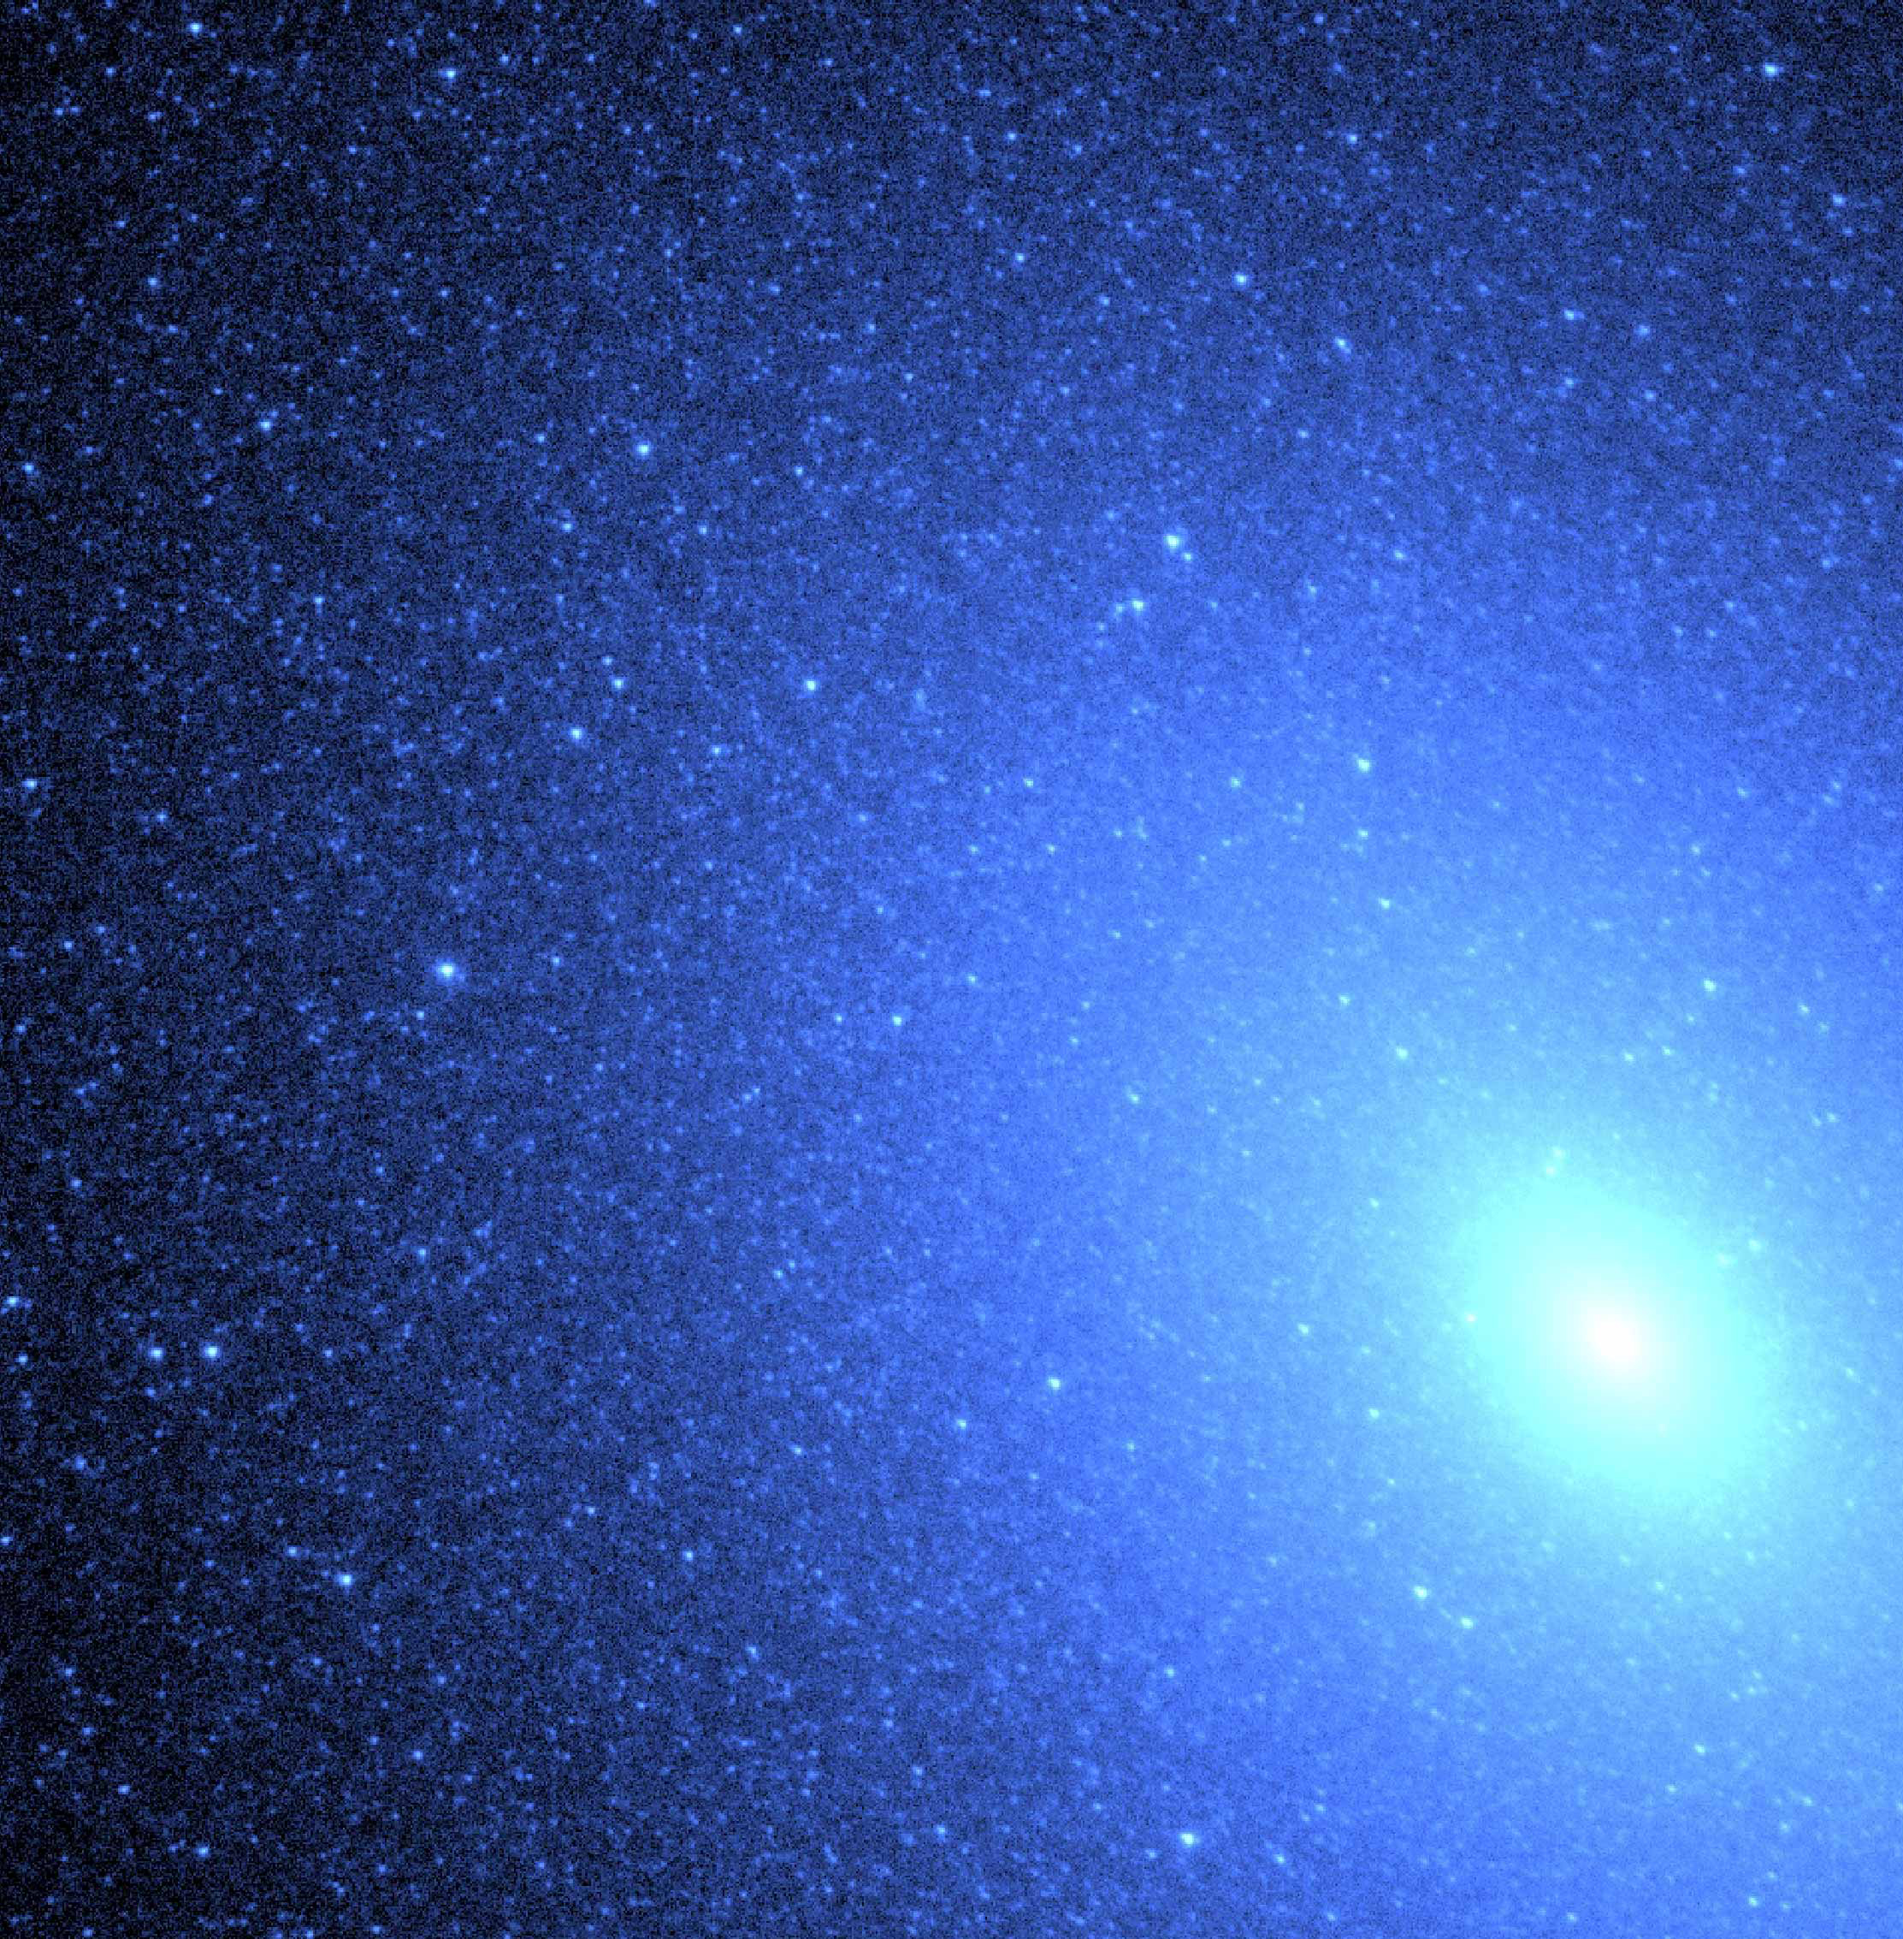
Roadmap
What are ULXs and what’s so interesting about them?
Discovery of pulsations in ULXs -> neutron stars!
Methods: Systematic Search, Spectral Analysis & Statistics
Results: Insight into Analysis of Neutron-star powered ULX candidates
After the search: Discerning the Real from the Fake

Slide 3
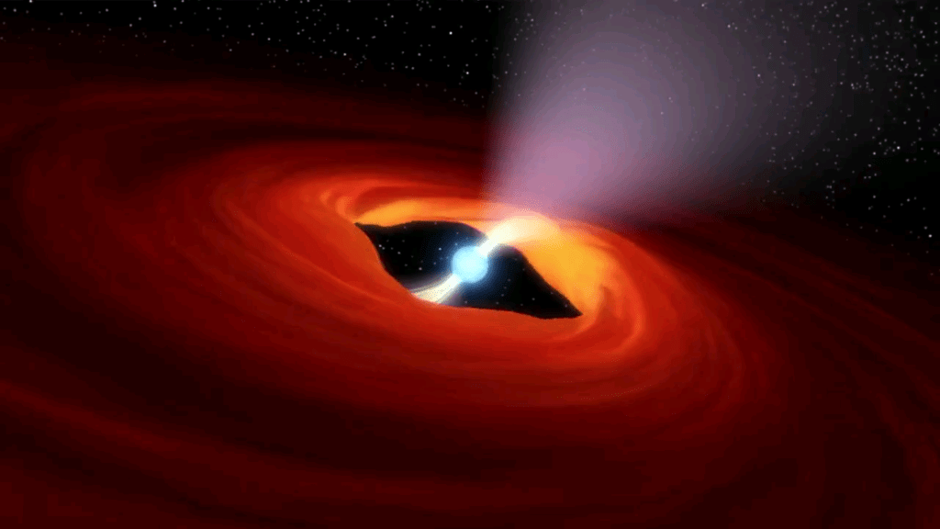
Ultraluminous X-Ray Sources (ULXs)
ULXs are non-nuclear X-ray sources in nearby galaxies that are not associated with the central supermassive black hole or active galactic nucleus.
Brighter than intergalactic black hole systems and typically radiates at a luminosity of L > 10^39 ergs/s and exceed the Eddington limit for a stellar-mass black hole (10 M⊙).
Notes:
The term ULX is numerically motivated

Slide 4


Eddington Luminosity
The accretion limit of a celestial object is the maximum luminosity a star reaches its hydrostatic equillibrium.
The radiation pressure is caused by high temperatures within the star, and gas pressure is low enough such that radiation pressure dominates within certain regions of the star.
A star’s inward gravitational field is balanced by this radiation force.
Can be used to explain the luminosity of accreting black holes.
Consider the hydrostatic equilibrium:
$\frac{dP}{dr}=\frac{kp}{c}F_{rad}$ = $\frac{GMp}{r^{2}}$, where $F=\frac{L}{4πr^{2}}$
We can solve for the Ed.. Limit: $L_{ed}=\frac{4πGc}{k}M$

Slide 5
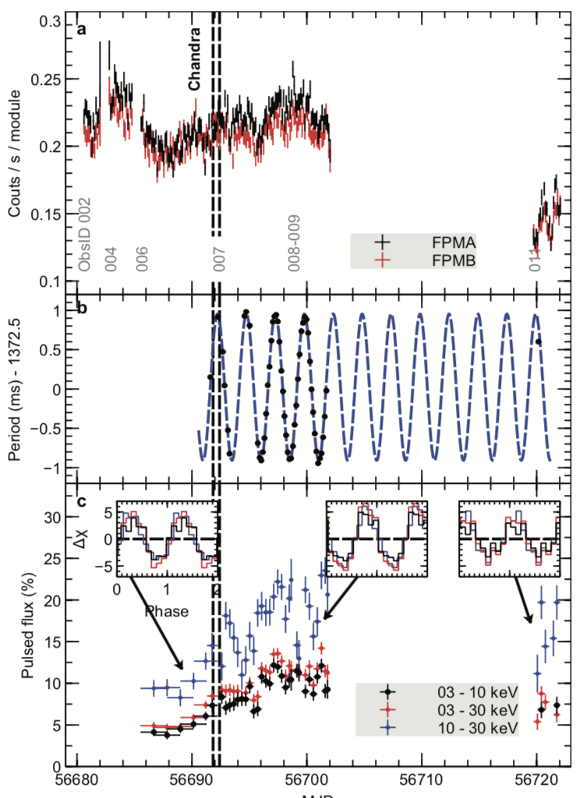
Neutron Star-powered ULXs
Bachetti et al’s 2014 discovery that a neutron star powered M82 X-2 stirred uncertainty about its magnetic field strengths.
Bachetti et al. found that neutron stars may not be a rare occurrence within ULXs.

Slide 6
Brightman et al (2014) estimated the field strength of ULX-8 in M51 to be on order of 10^15 G

Slide 7
Our Mission
Identify neutron star-powered ULXs by locating proton cyclotron resonance scattering features (CRSFs) (Mihara et al, Tiengo et al) via analysis of Chandra & XMM data
Find more distinguishing factors as the cause of super-Eddington luminosity (field strength,mass, luminosity as a determinant)
Precisely measure the magnetic fields of such ULXs (Mihara et al, 1974)
Notes:
CSRFs produced by the transition of charged particles between quantized Landau levels

Slide 8
What are cyclotron resonance scattering features(CRSFs)?
CRSFs are caused by the transition of charged particles between Landau levels produced by a magnetic field.
Cyclotron lines not only imply the presence of a neutron star, but gives a direct measurement of its magnetic field strength.
Brightman et al. (2018)

Slide 9
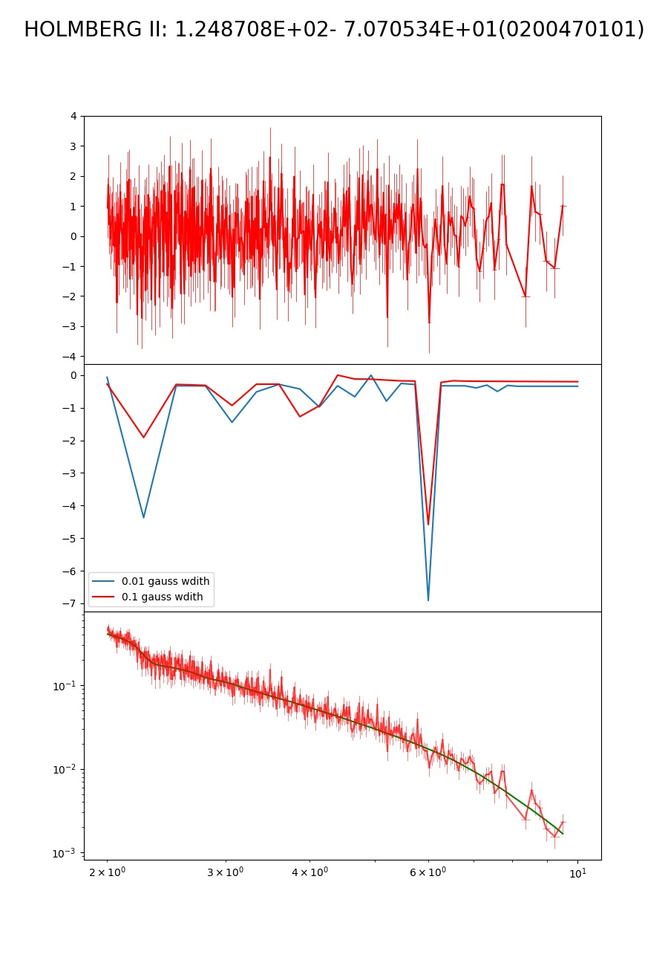

Considered EPIC-PN detectors on XMM-Newton X-Ray telescope.
Considered sources with 10,000+ intensity counts
Fitted spectra with cutoff power-law in conjunction with a gaussian line profile to look for absorption lines
Used the chi-squared test (Chernoff et al., 1964) with a statistical significance threshold of about $χ^{2}$ ~ 10.

Slide 10
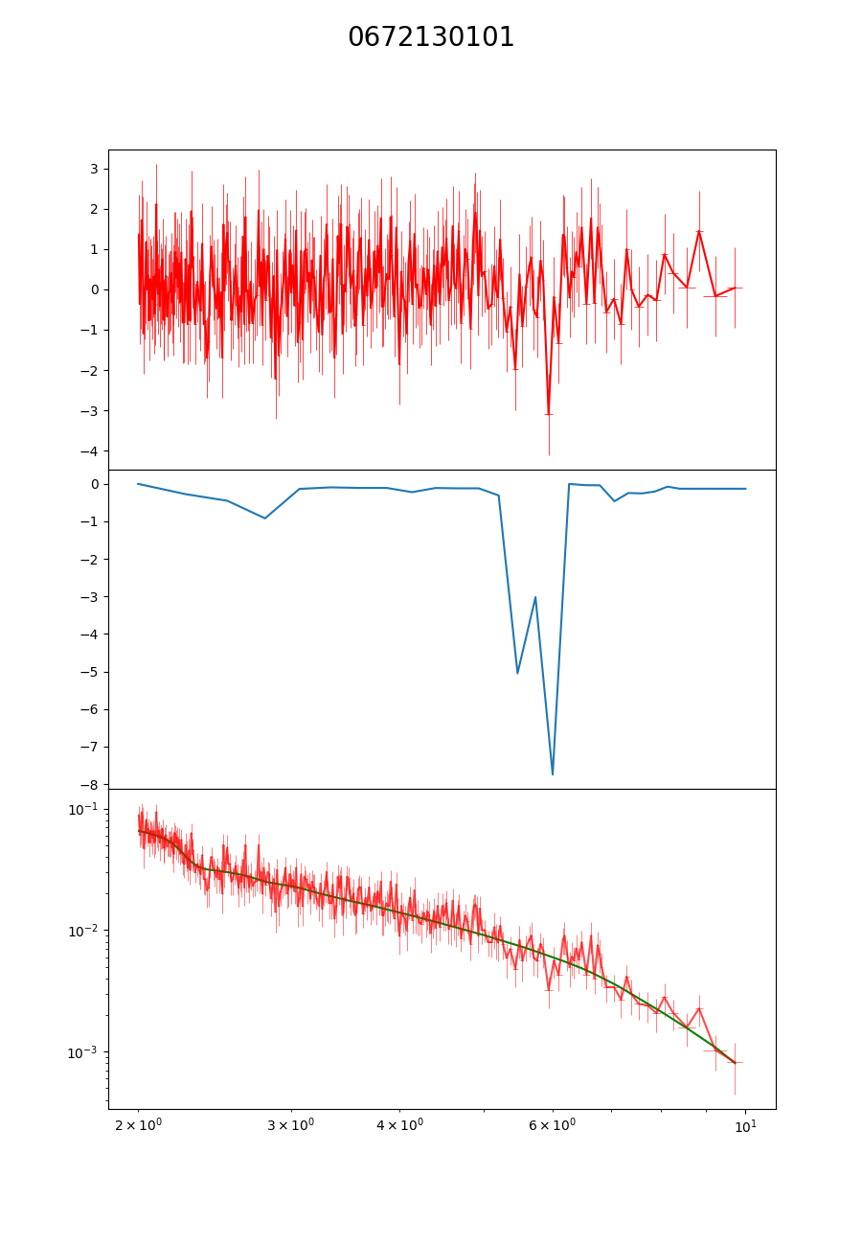
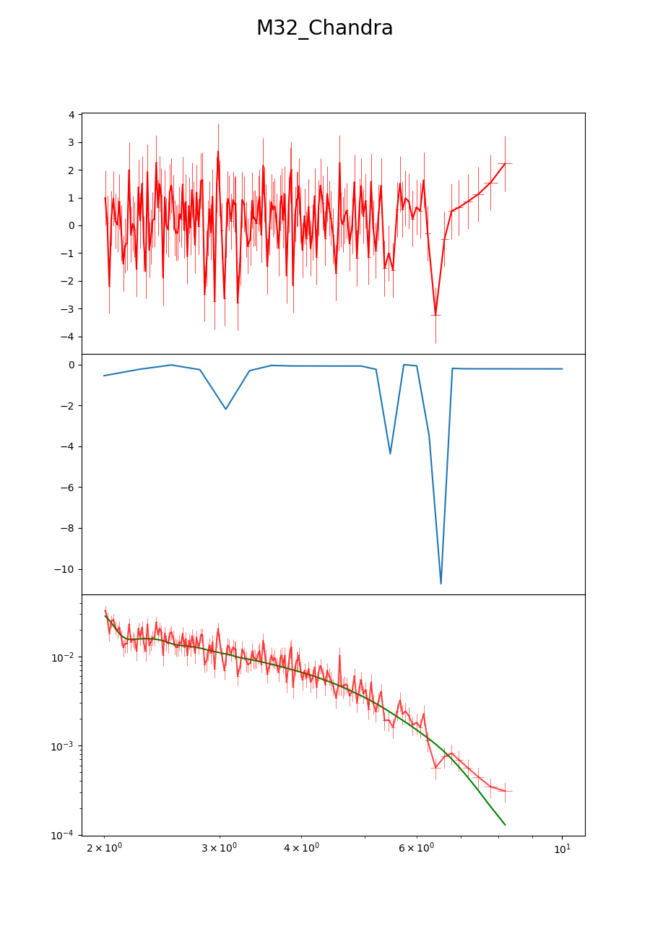

Promising Candidate: M32(NGC 221)
Satellite Galaxy of M31, the Andromeda Galaxy
Three separate sources
Absorptions lines found in two different observations
$E=6$ keV in XMM-Newton (067210101)
$E=6.5$kEV in Chandra (5680)

Slide 12

Promising Candidate: M32(NGC 221)
Favorable conditions for XMM reduction were a radius of 60, pattern 0, and rate of 1.2. Flaring found during XMM observation.
Incorporated 78.1% of source spectrum; 8671photon counts.
Chandra had 99.9% of source spectrum; 3886 counts.
Ran fakeit simulations on XSPEC to inspect for statistical fluctuations
XMM: confidence of $3σ$, false positive rate of 0.0074.
Chandra: confidence o$f 2σ$, false positive rate of 0.0522.
Notes:
Why does Chandra have lower counts?

Slide 13
Why do they have different energies?
May be due to different orientations of the neutron star field
XMM Observation started 6/27/11
Chandra observation at (?)
May be an atomic absorption line, and therefore a different analysis is needed.
May be a detector deficiency, such as those seen in observations of other sources.

Slide 14

TO-DO
Look at more Chandra observations of M32
Rationalize the possible existence of an atomic absorption line, which would therefore need a different analysis.
Spectroscopic blueshift at $z=0.0007$
Iron outflow?
Consolidate XMM EPIC-PN data by supplementing with EPIC-MOS data

Slide 15
Potential Challenges & Future Work
Determining proper parameters to fit our absorption model with to get a better look at features.
Differentiating between atomic absorption vs CRSFs.
Dealing with detector issues (NGC 1313).
Data required for pulsations & harmonic lines -> More observations needed

Slide 16
Acknowledgements
Funded as a WAVE Fellow by Southern California Edison
Caltech Student-Faculty Programs
NASA NuStar Team/Space Radiation Lab
Caltech PMA Department

